Slide 1

Introduction to Matlab

Slide 2
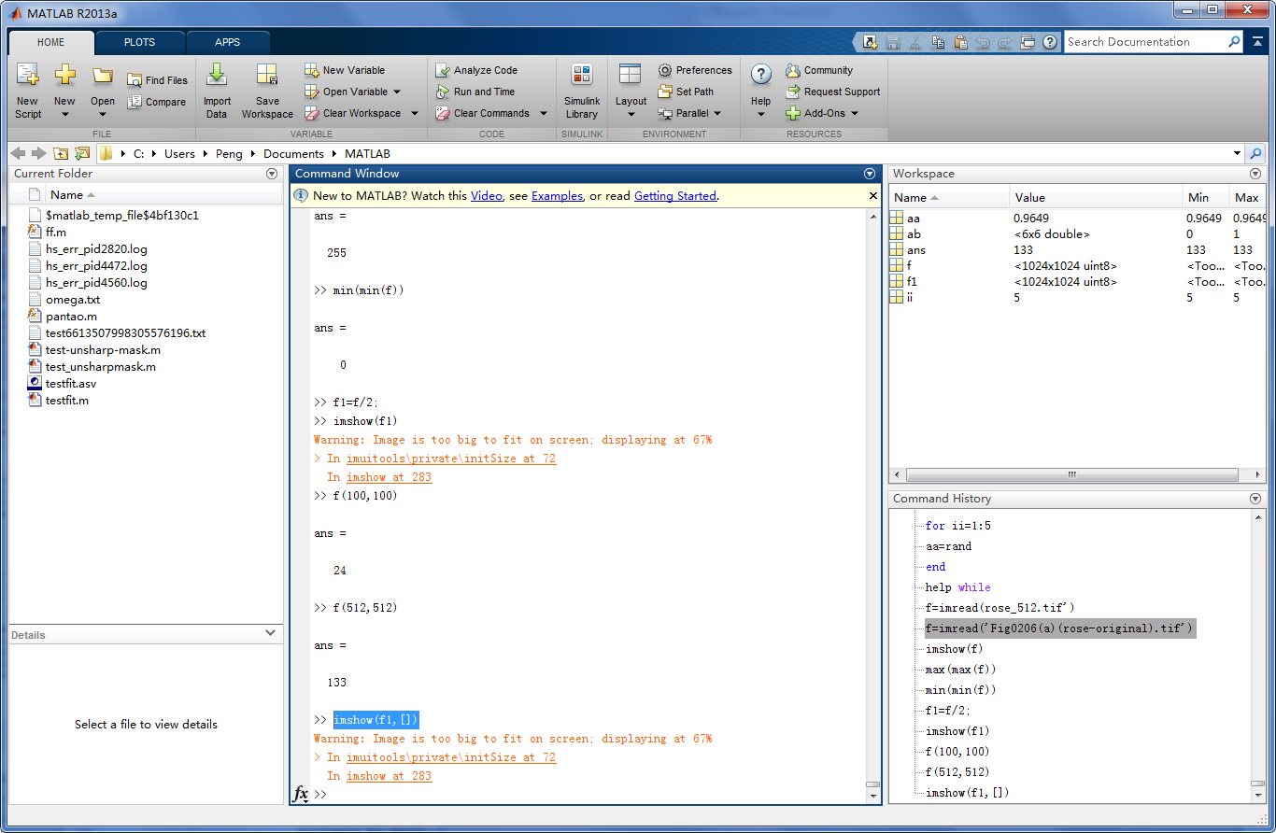
当前目录
工作空间
命令窗口

Slide 3
Topics
M-files
Vectors and Matrices
Functions
Control Statements

Slide 4
M-files
M-files are files containing Matlab code
• There are two kinds of m-files: script files and function files
• Script files do NOT take input arguments or return the output arguments
• Function files may take input arguments or return output arguments
• Percent sign “%” indicates a comment line
Script file example
Function file example
% script file graphics x = 0:1:10;
y = x.^2; plot(x,y); grid on;
% function stat calculates minimum
% maximum, and average of input vector x function [min_x,aver_x,max_x]=stat(x) min_x=min(x);
max_x=max(x); aver_x=sum(x)/length(x);

Slide 5
Vectors and Matrices
The most important variables for us are vectors and matrices. It is easy to create them in Matlab
X = [1 2 3 4 5]; % row vector of size 1x5
Y = [11; 12; 13]; % column vector of size 3x1 Z = [2 1 0; 1 2 1; 0 1 2]; % square matrix of size 3x3
V = [1 0 0 0; 0 1 0 0]; % rectangular matrix of size 2x4
Functions used to create some common matrices:
zeros ones eye rand
% create zero matrix
% create matrix of ones
% create identity matrix
% create matrix containing preudo-random values (uniform distr. on the unit interval)
Syntax (shown for zero, but similar for other commands)
X = zeros(n)
Y = zeros(n,m)
% nxn zero matrix
% nxm zero matrix

Slide 6
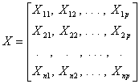
Vectors and Matrices
Reference to vector and matrix elements
X(i) i-th element of vector X
X(:,2)
X(i,j)
X(i,:)
X(:,i)
element x_{ij} of matrix X i-th row of matrix X
i-th column of matrix X
X(2,:)
Some common functions used with vectors and matrices:
Length() Size()
min()
max()
sum()
prod()
mean()
std()
sort()
% returns length of a vector
% returns size of a matrix
% returns minimum entry of a vector (works column-wise for matrices)
% returns maximum entry of a vector (works column-wise for matrices)
% returns sum of vector elements (works column-wise for matrices)
% returns product of vector elements (works column-wise for matrices)
% returns mean value of vector elements (works column-wise for matrices)
% returns standard deviation of vector elements (works column-wise for matrices)
% sorts vector elements in ascending or descending order
Refer to Matlab help for syntax information (type ‘help command_name’ to get command info)

Slide 7
Matrices
Matrix operations (sizes of involved matrices must agree)
X+Y matrix addition
X-Y
X*Y X’
det(X)
inv(X) X^n X.*Y
X.^n diag(X)
matrix subtraction matrix multiplication matrix transposition
determinant of a square matrix inverse of a square matrix matrix power (square matrices)
component-wise matrix multiplication
component-wise matrix power (e.g., each element is squared, if n=2) main diagonal of a matrix
Elementary mathematical functions work with matrices in a component-wise way, e.g.,
exp(X) sqrt(X) sin(X) log(X)
perform respective operations on individual matrix entries

Slide 8
Functions
Function definition:
function [O₁,O₂,…,O_{k},varargout] = function_name(I₁,I₂,…,I_{m},varargin)
% …
% function body goes here
% …
I_{j} – input arguments O_{j} – output arguments
varargin – variable input argument list (referred to as varargin{1}, varargin{2}, etc.) varargout – variable output argument list (referred to as varargout{1}, varargout{2}, etc.)
Number of input and output arguments can be determined inside the function using nargin and nargout commands

Slide 9
Functions
Function example:
% function power_function calculates x^m, where m is 2 by default
% optionally, derivative of the x^m is also calculated function [f,varargout] = power_function(x,varargin)
% check the number of input arguments if nargin==1
m=2; % one input argument => take default power factor else
m=varargin{1}; % take the power factor from varargin{1} end
f=x^m; % calculate function value if nargout==2
varargout{1}=m*x^(m-1); % calculate derivative of x^m end
Example function calls:
f = power_function(5) % returns f = 25
f = power_function(5,3) % returns f = 125
[f,g] = power_function(5) % returns f = 25 and g = 10

Slide 10
Inline Functions
Inline function is a convenient way to construct and use simple Matlab functions on the fly
f = inline(expr,arg1,arg2,…) - constructs an inline function object f from the Matlab expression, whose input arguments are specified by arg1, arg2, …
Example: create function f that represents the formula f = 3x + 5y²
f = inline(‘3*x+5*y^2’,’x’,’y’)
Run the inline function f with arguments x = 2 and y = 3
z = f(2,3)
This would assign z the value 51

Slide 11
Functions Handles
Any Matlab function can have a function handle assigned to it, which can be used as a mean of referencing the function. A function handle is typically passed in an argument list to other functions. This is particularly useful for optimization.
Creating a function handle use @ sign
f_handle = @sin;

Slide 12
Functions Handles
Creating a function handle from an existing function:
f_handle = @sin;
It then can be passed to another function.
Example:
function plot_f(f_handle,x) plot(x, feval(f_handle,x));
%define a function that accepts a function handler as argument
%also allows using handle as function name plot(x, f_handle(x))
Function plot_f evaluates function referenced by f_handle and plots it
plot_f(@sin,-pi:0.01:pi)
will plot sin within the interval [–π,π]

Slide 13
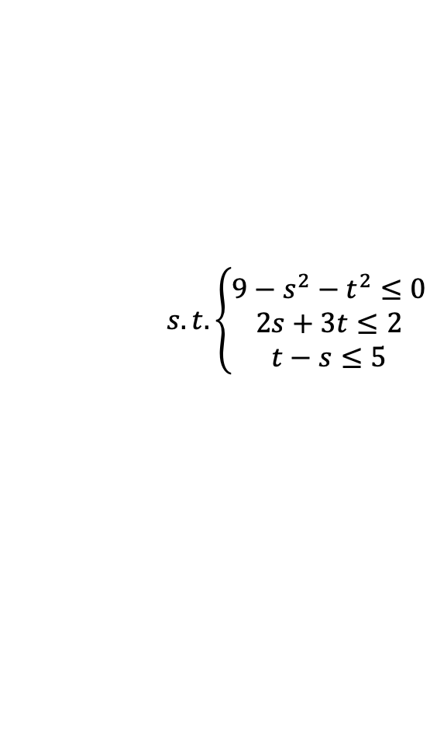

Functions Handles
Example:
$$\min{f\left(s, t\right)= s^{4}−4s−8t+15}$$
$$s.t. \left\{\begin{aligned}9−s^{2}−t^{2}≤0 \\ 2s+3t≤2 \\ t−s≤5\end{aligned}\right.$$
Definition of the target function:
Definition of constraints:
function [c, ceq] = cons(x)
c = [9-x(1)^2-x(2)^2];
ceq = [ ];
function y=fun(x)
y=x(1)^4-4*x(1)-8*x(2)+15;
%A and b represent the linear constraint part
A=[2 3;1 -1];
b=[2;5];
[x, fval, exitflag, output]=fmincon(@fun,[1 2],A, b, [], [], [], [], @cons)

Slide 14
Anonymous Functions
a function that is not stored in a program file, but is associated with a variable whose data type is function_handle. Anonymous functions can accept inputs and return outputs, just as standard functions do.
However, they can contain only a single executable statement.
Example:
sqr = @(x) x.^2; %%define an anonymous function
Use the function as if it is a standard function
a = sqr(5)
The result is
a =
25

Slide 15
Control Statements: for
Syntax of the for loop
for k = array
% block of commands end
The commands between the for and end statements are executed for all values stored in the array
Example: find first 15 Fibonacci numbers
x(1)=0
x(2)=1
for j=3:15
x(j)=x(j-1)+x(j-2); end
The result is: 0 1 1 2 3 5 8 13 21 34 55 89 144 233 377

Slide 16
Control Statements: while
Syntax of the while loop
while expression
% block of commands end
Commands are executed as long as expression gives a logical value 1;
while is used when the number of repetitions is not known a priori
Example: how many years does it take to accumulate >$100,000 if you deposit $2,000 every year and interest rate is 5%
x=0; year=0; while x<100000
year=year+1; x=1.05*(x+2000);
end
The result is: the accumulated amount will be $100,227 after 25 years

Slide 17
Control Statements: if-then-else
Syntax
if expression
% commands (evaluated if expression is true) end
if expression
% commands (evaluated if expression if true) else
% commands (evaluated if expression if false) end
if expression1
% commands (evaluated if expression 1 if true) elseif expression2
% commands (evaluated if expression 2 if true) elseif expression3
… else
% commands (evaluated if all previous expressions are false) end

